Slide 1
데이터변형보고서

Slide 2
install.packages("googleVis")
Fruits
aggregate(Sales~Year,Fruits,sum)
aggregate(Sales~Fruit,Fruits,sum)
aggregate(Sales~Fruit,Fruits,max)
aggregate(Sales~Fruit+Year,Fruits,max)
mat1<-matrix(c(1,2,3,4,5,6),nrow=2,byrow=T)
mat1
apply(mat1,1,sum)
apply(mat1,2,sum)
apply(mat1[,c(2,3)],2,max)
list1<-list(Fruits$Sales)
list1
list2<-list(Fruits$Profit)
lapply(c(list1,list2),max)
sapply(c(list1,list2),max)
lapply(Fruits[,c(4,5)],max)
sapply(Fruits[,c(4,5)],max)
Fruits
tapply(Sales,Fruit,sum)
attach(Fruits)
tapply(Sales,Fruit,sum)
tapply(Sales,Year,sum)
vec1<-c(1,2,3,4,5)
vec2<-c(10,20,30,40,50)
vec3<-c(100,200,300,400,500)
mapply(sum,vec1,vec2,vec3)

Slide 3
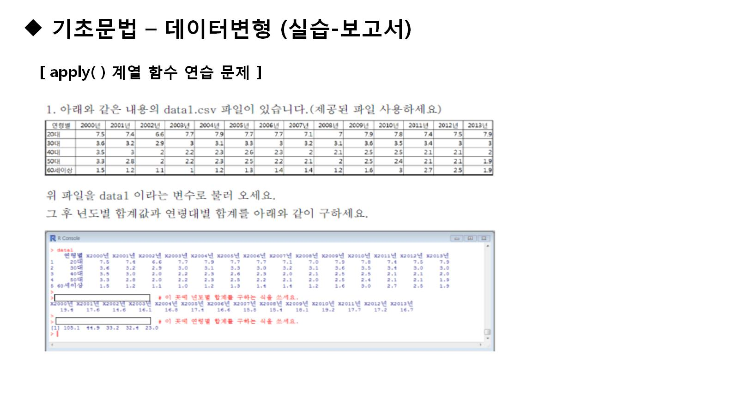

Slide 4
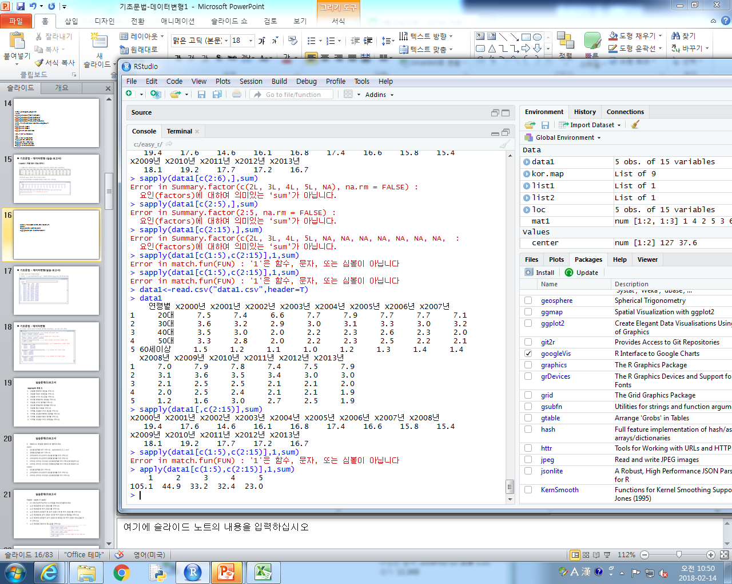
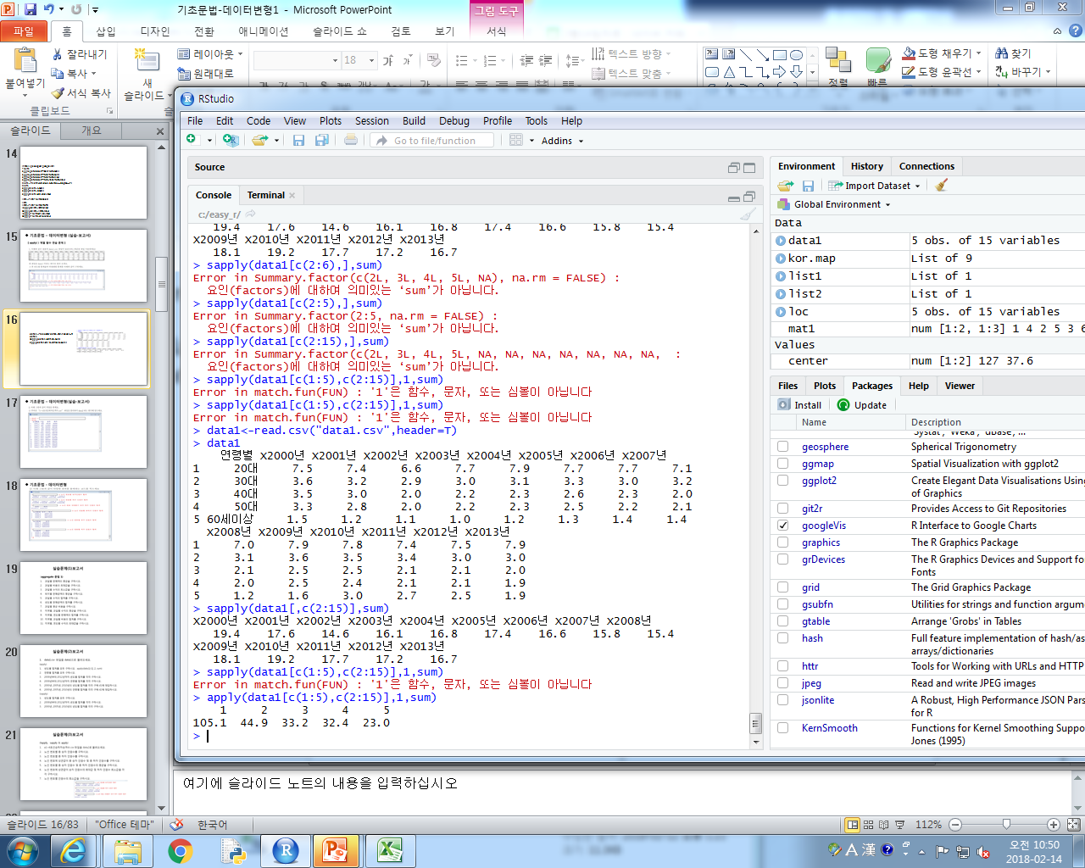
data1<-read.csv("data1.csv",header=T)
data1
sapply(data1[,c(2:15)],sum)
apply(data1[c(1:5),c(2:15)],1,sum)

Slide 5
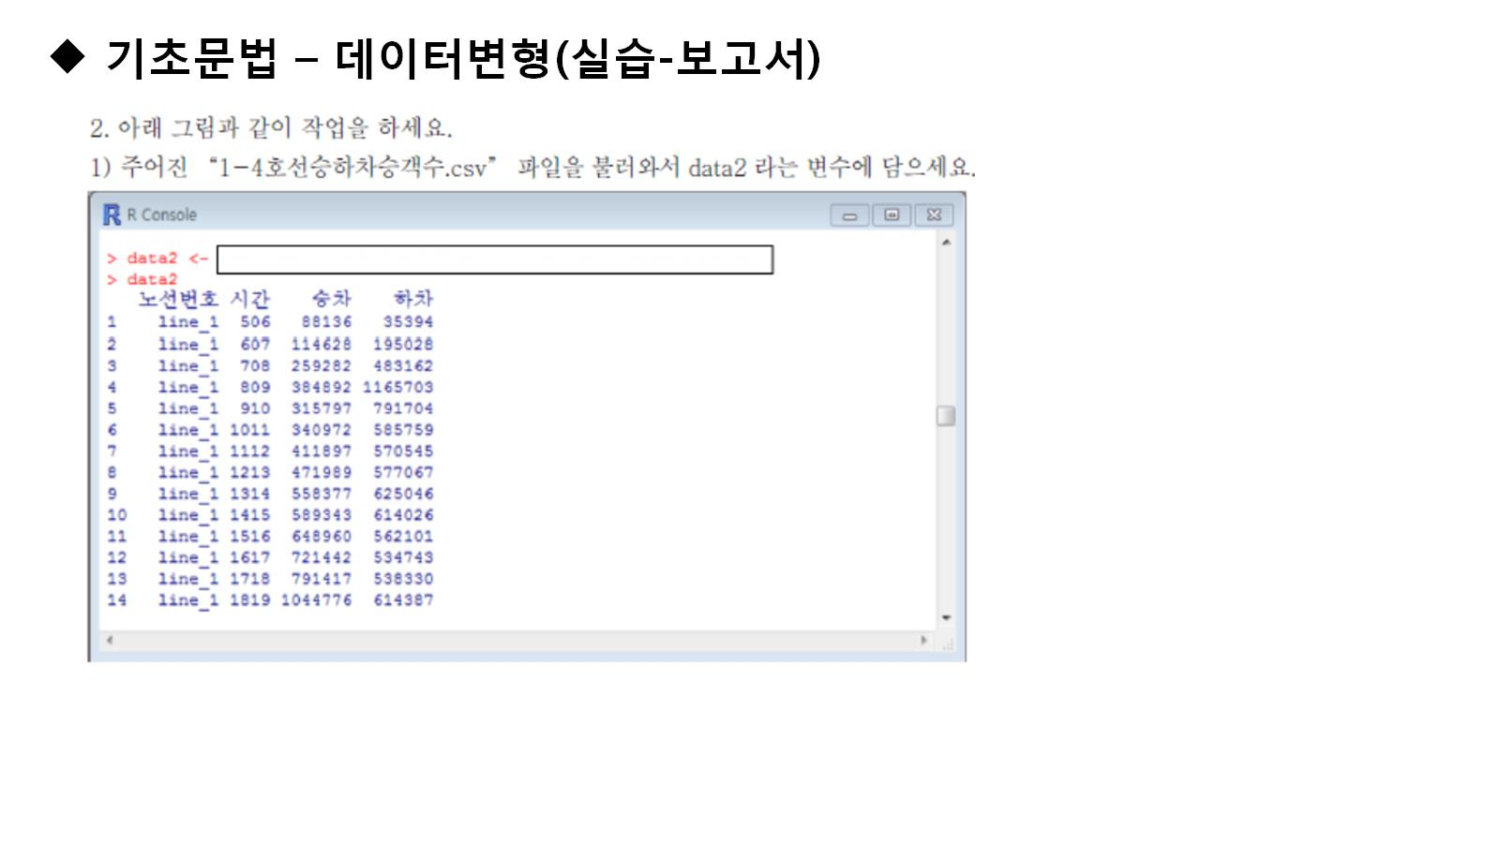

Slide 6
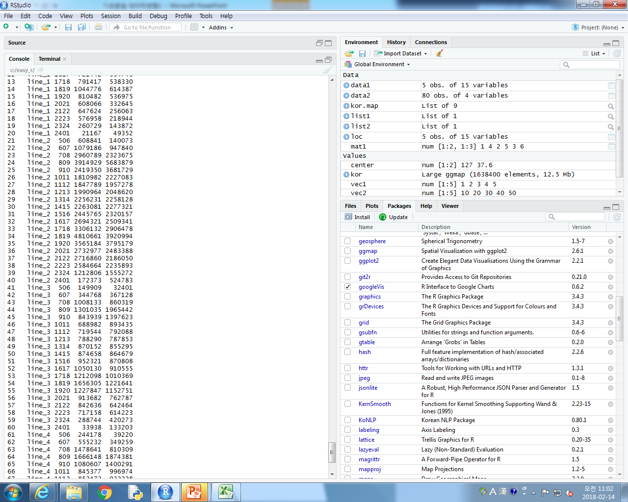
data2<-read.csv("1-4호선승하차승객수.csv",header=T)
data2

Slide 7
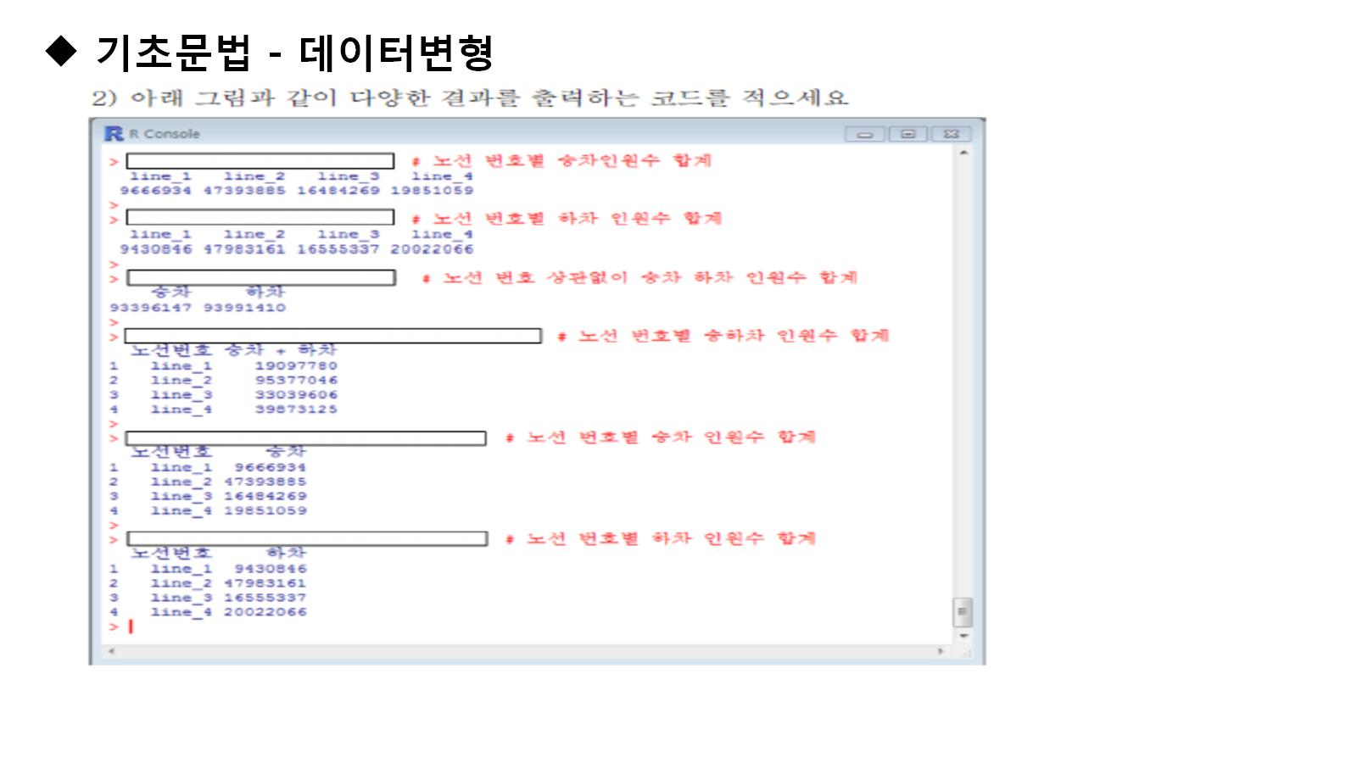

Slide 8
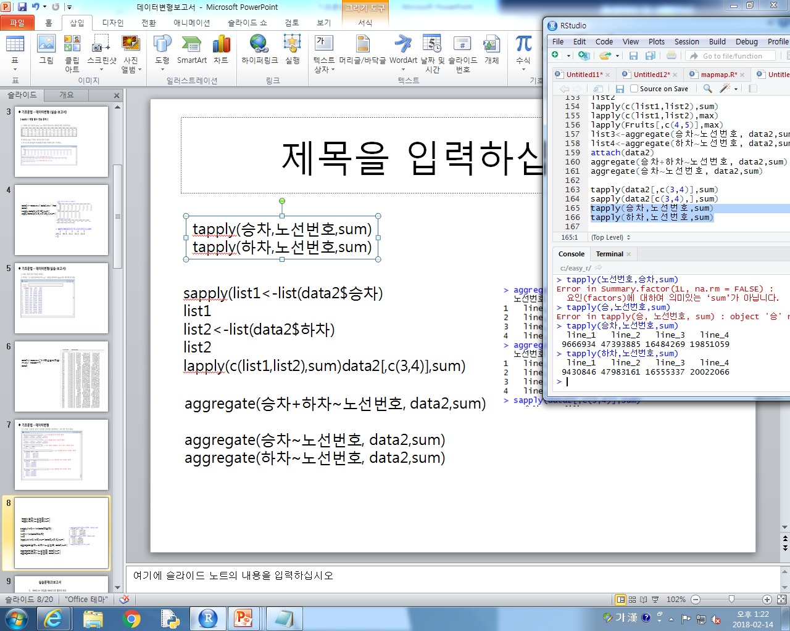
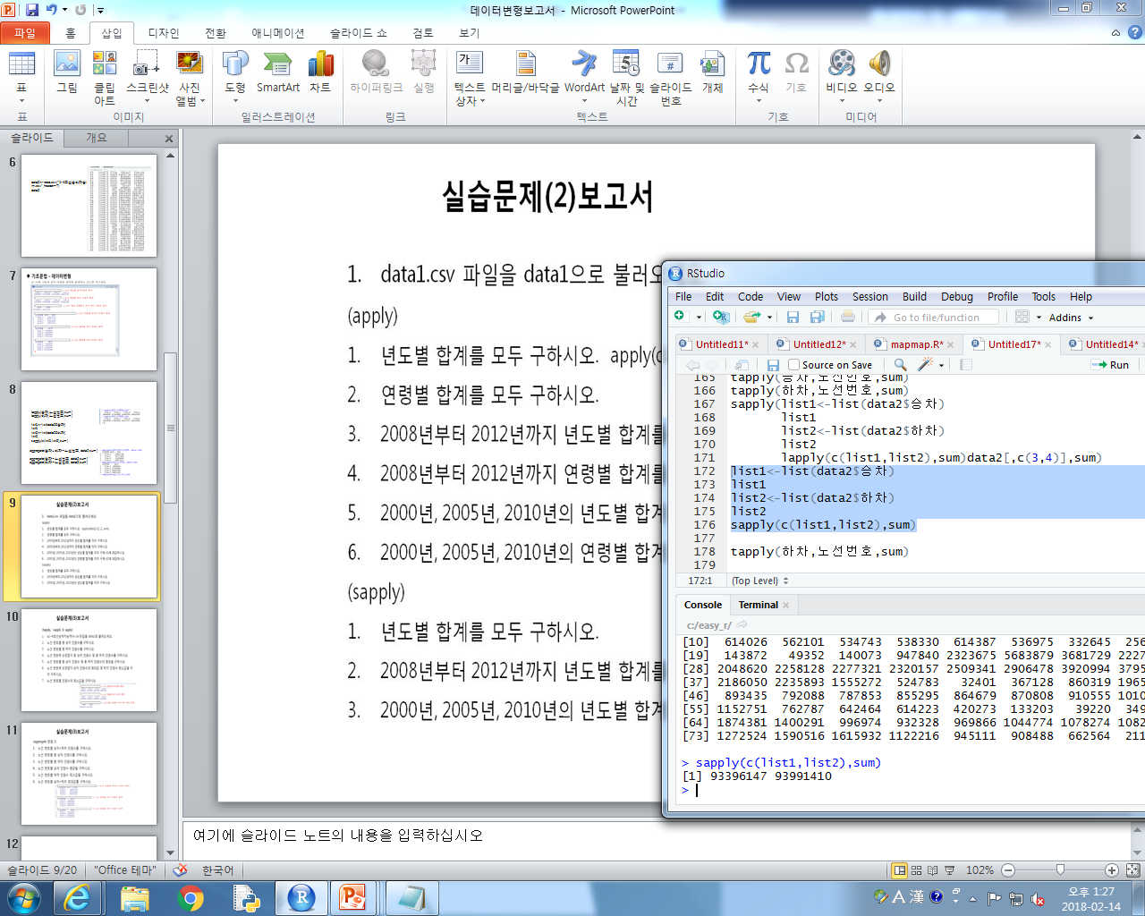
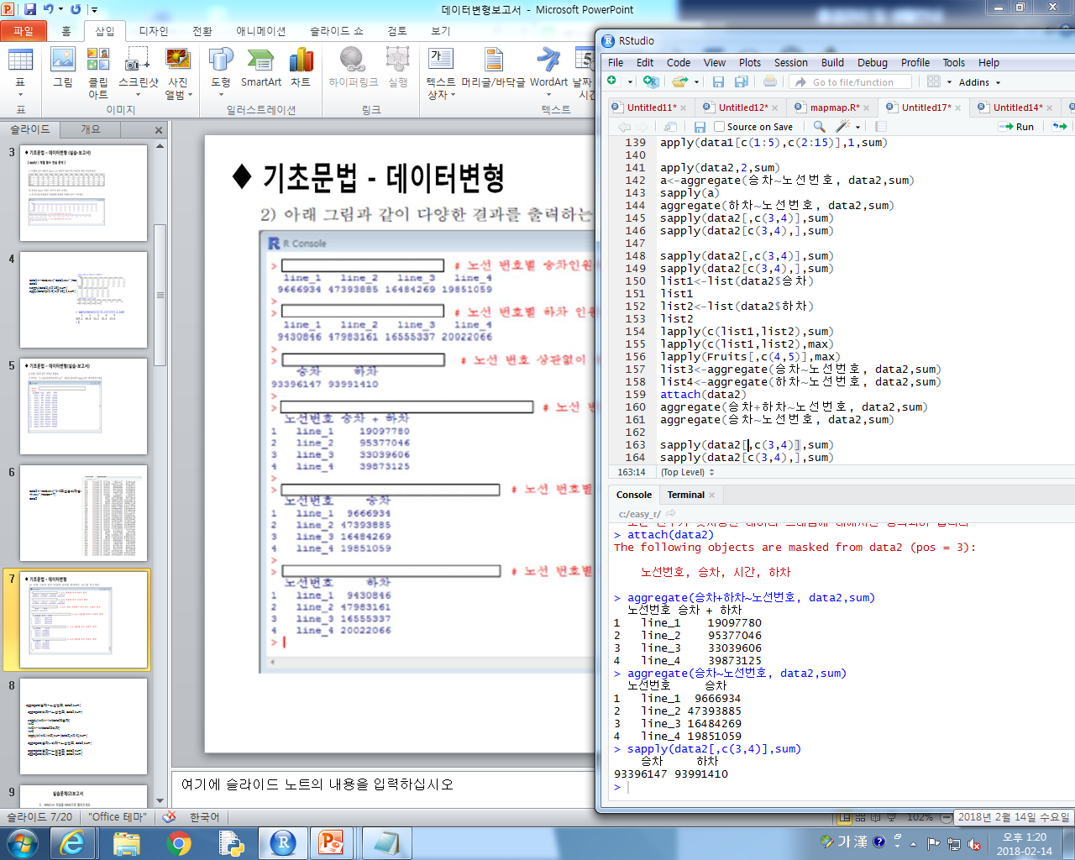
tapply(승차,노선번호,sum)
tapply(하차,노선번호,sum)
list1<-list(data2$승차)
list1
list2<-list(data2$하차)
list2
sapply(c(list1,list2),sum)
aggregate(승차+하차~노선번호, data2,sum)
aggregate(승차~노선번호, data2,sum)
aggregate(하차~노선번호, data2,sum)

Slide 9
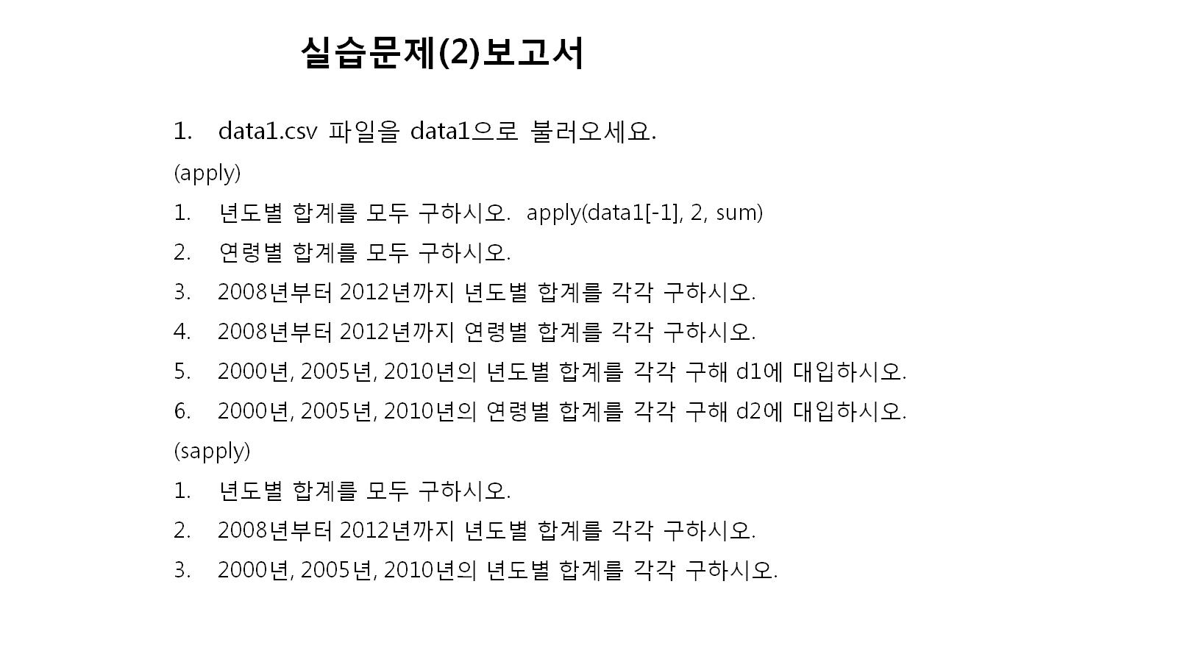

Slide 10
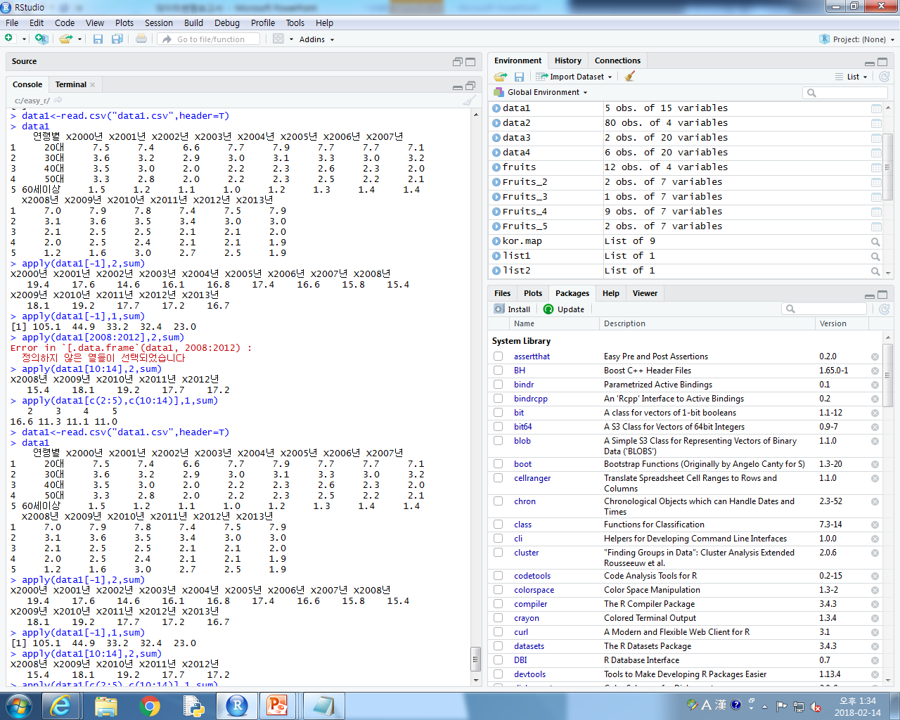
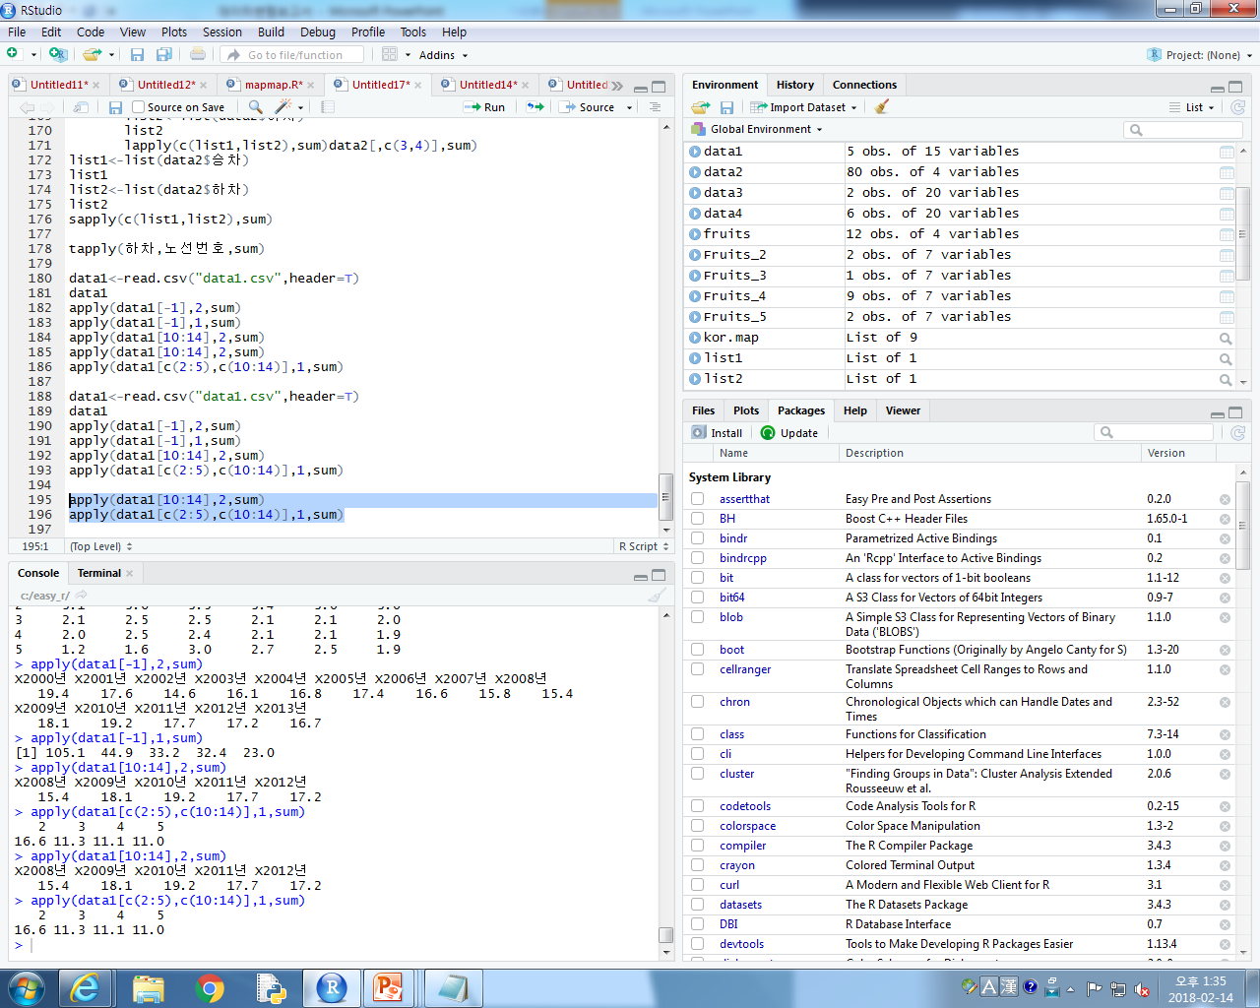
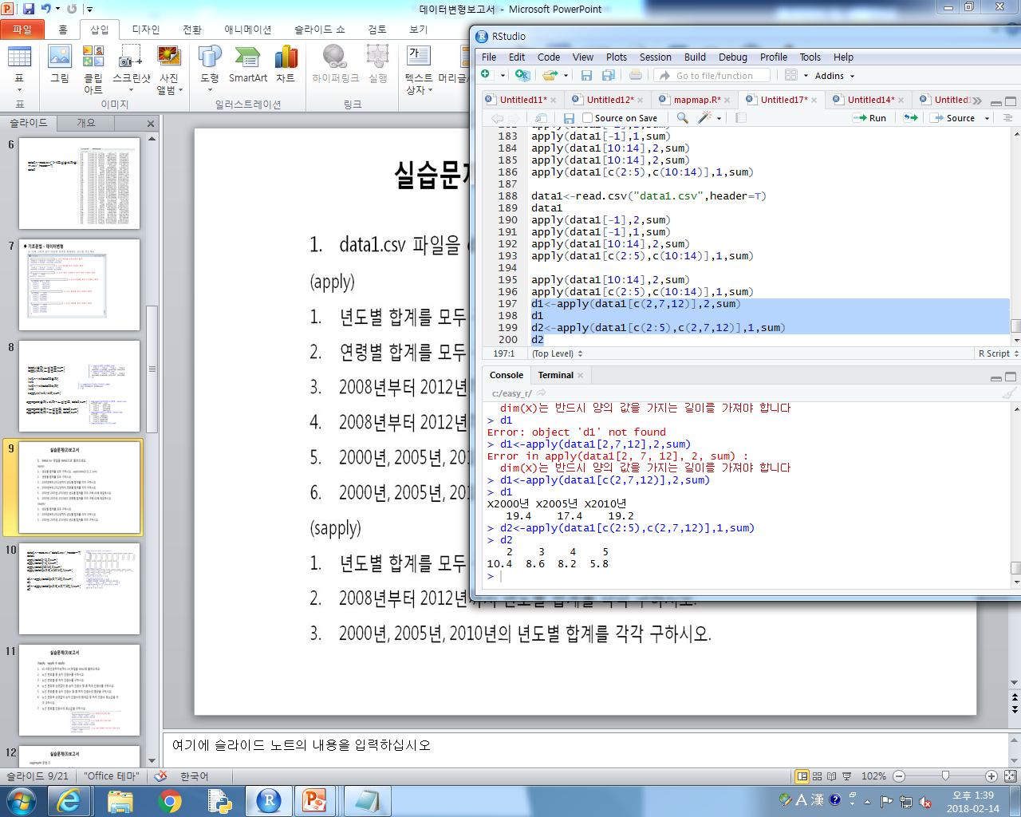
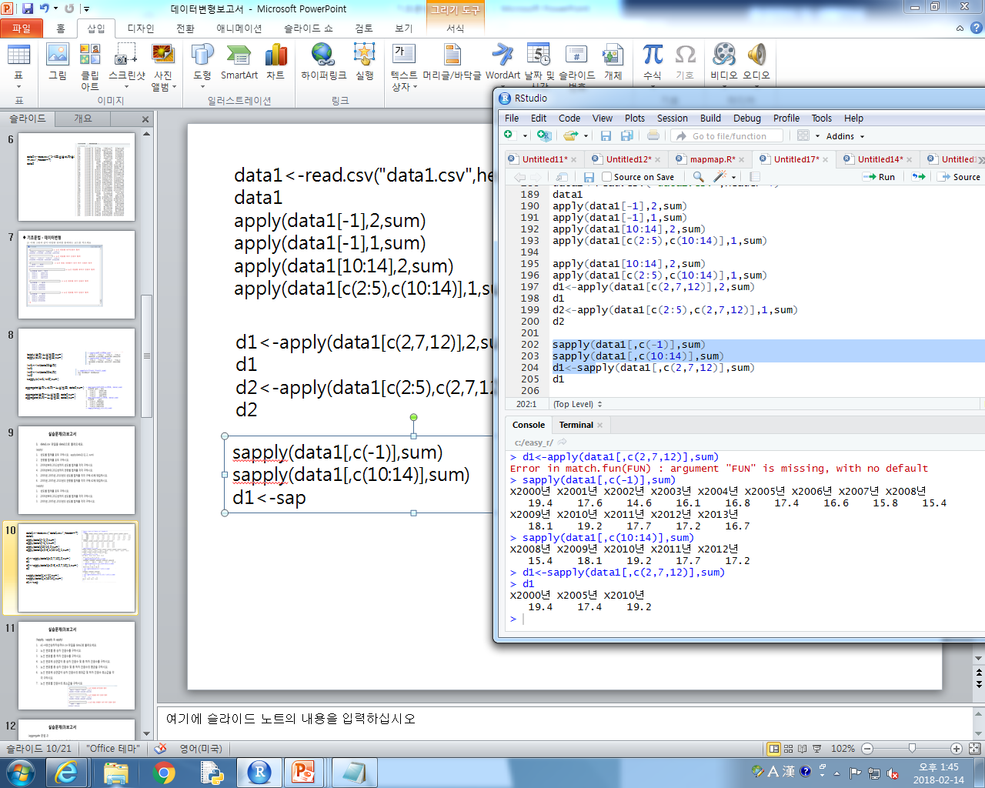
data1<-read.csv("data1.csv",header=T)
data1
apply(data1[-1],2,sum)
apply(data1[-1],1,sum)
apply(data1[10:14],2,sum)
apply(data1[c(2:5),c(10:14)],1,sum)
d1<-apply(data1[c(2,7,12)],2,sum)
d1
d2<-apply(data1[c(2:5),c(2,7,12)],1,sum)
d2
sapply(data1[,c(-1)],sum)
sapply(data1[,c(10:14)],sum)
d1<-sapply(data1[,c(2,7,12)],sum)
d1

Slide 11
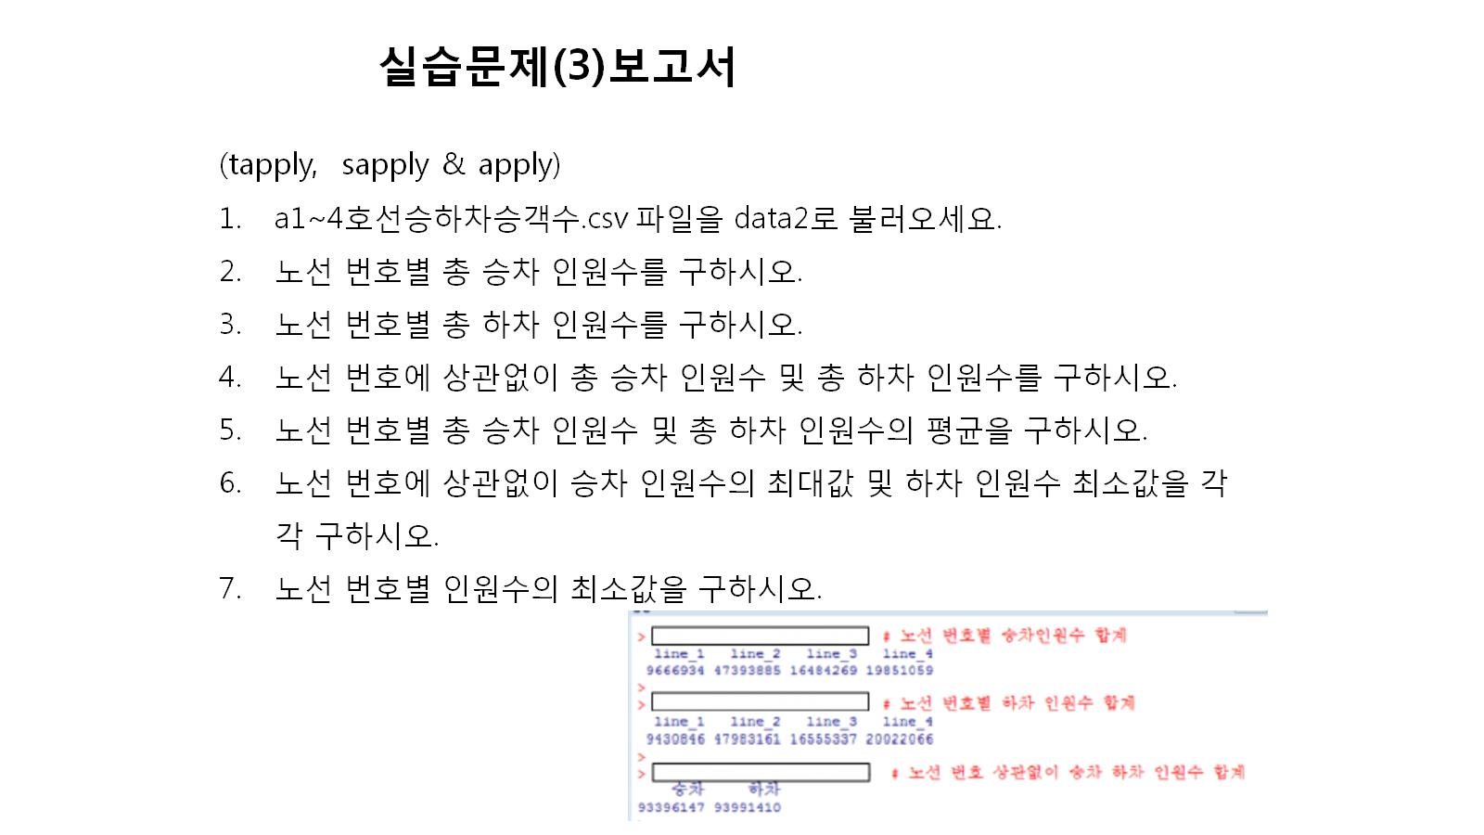

Slide 12
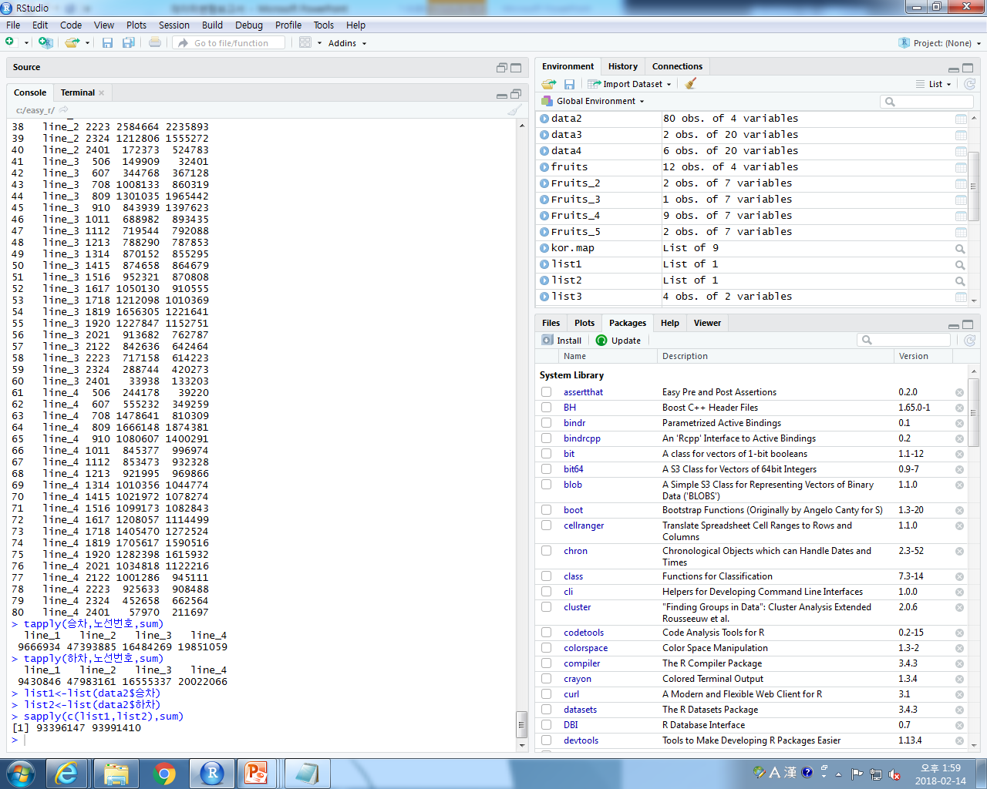
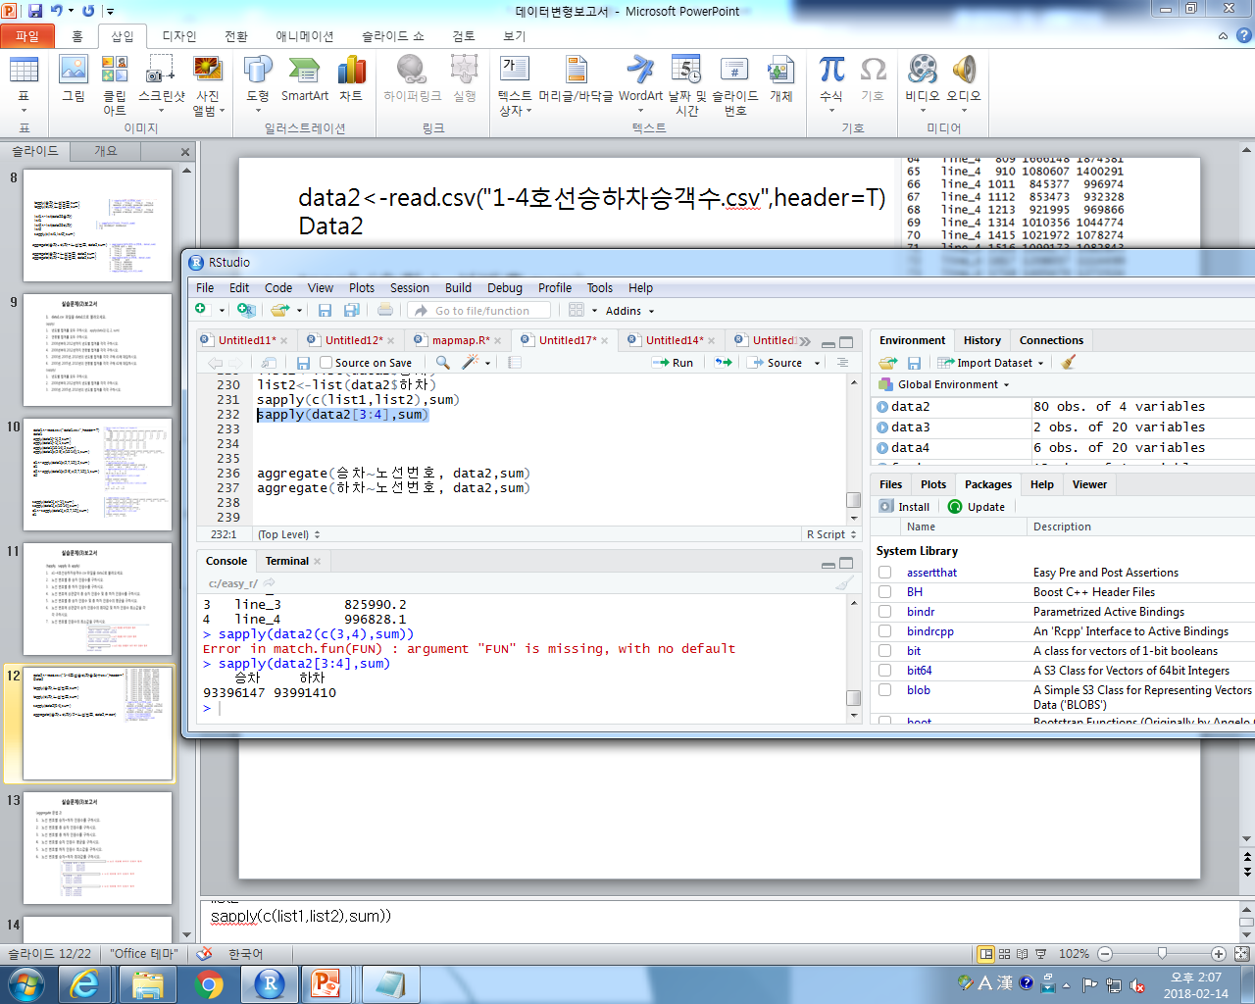
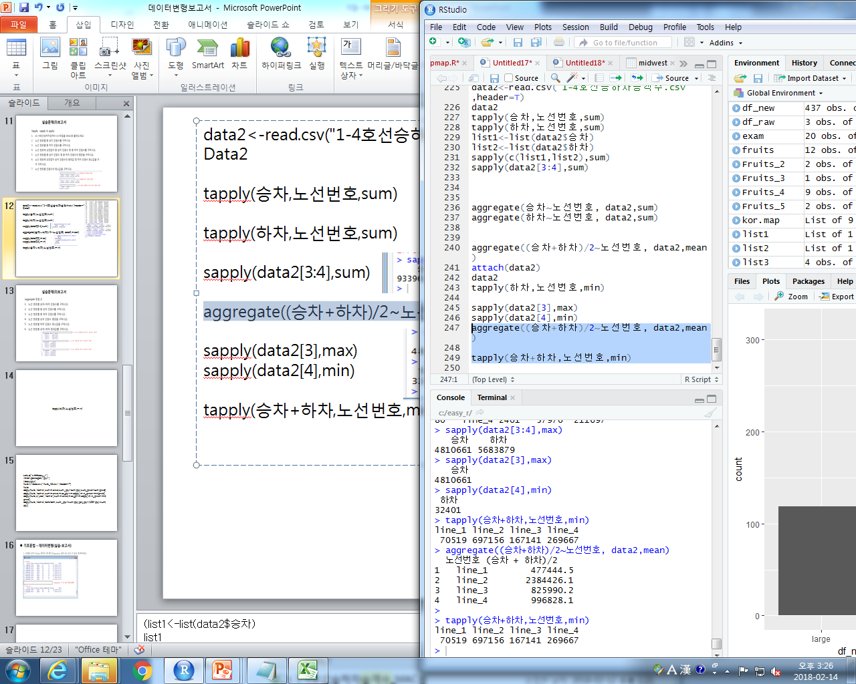
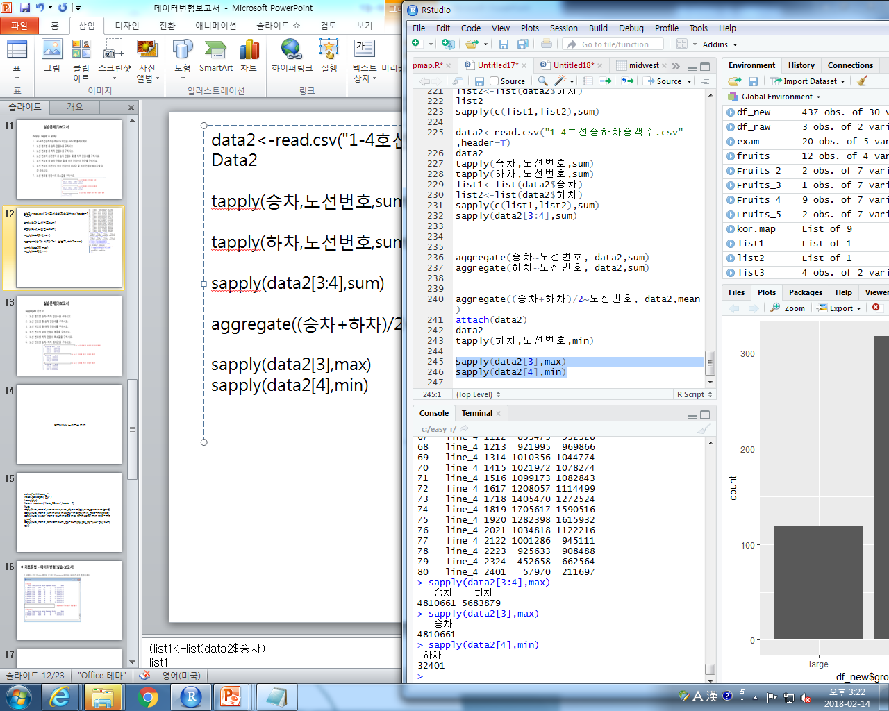
data2<-read.csv("1-4호선승하차승객수.csv",header=T)
Data2
tapply(승차,노선번호,sum)
tapply(하차,노선번호,sum)
sapply(data2[3:4],sum)
aggregate((승차+하차)/2~노선번호, data2,mean)
sapply(data2[3],max)
sapply(data2[4],min)
tapply(승차+하차,노선번호,min)
Notes:
(list1<-list(data2$승차)
list1
list2<-list(data2$하차)
list2
sapply(c(list1,list2),sum))

Slide 13
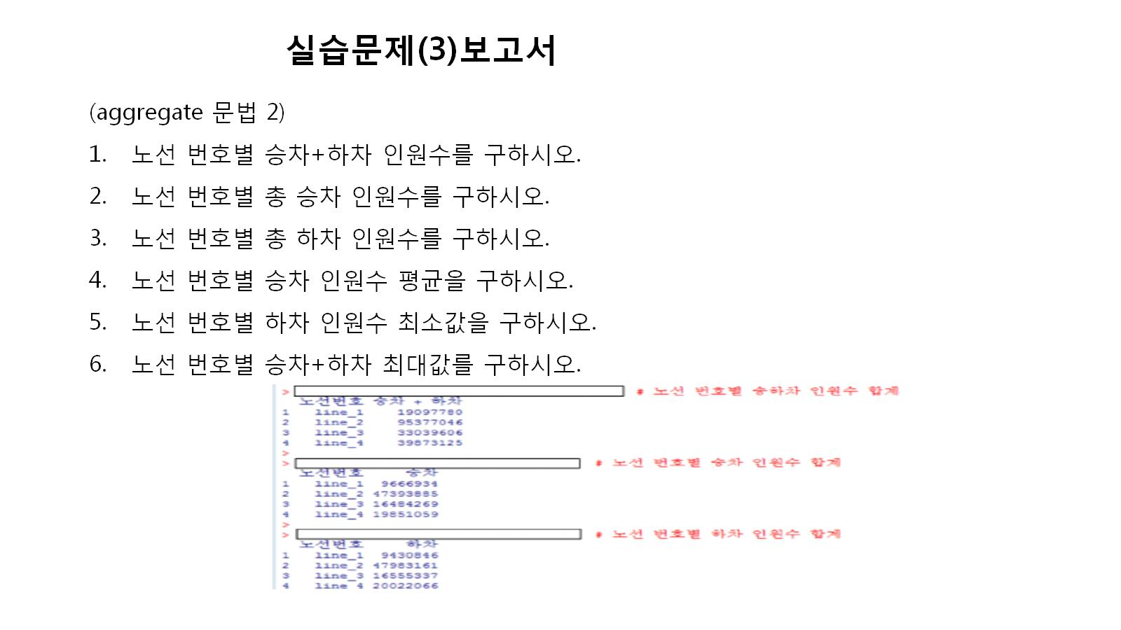

Slide 14
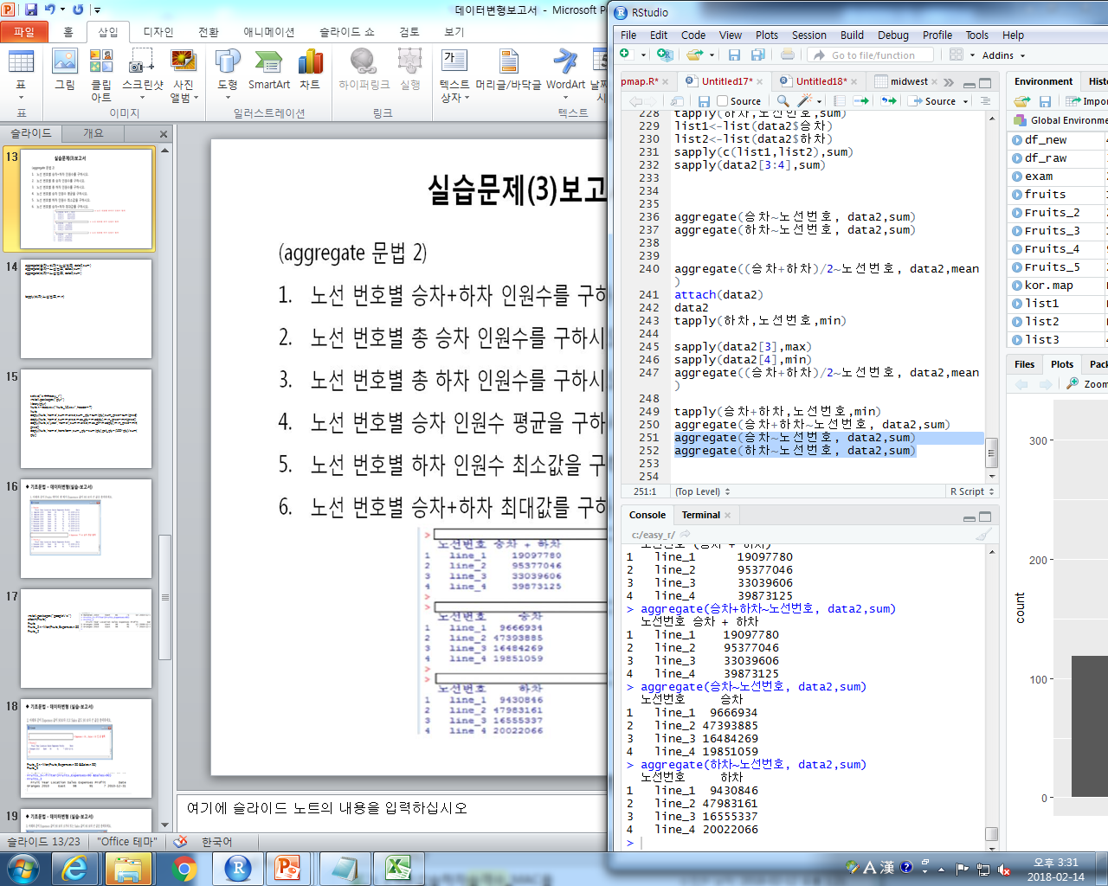
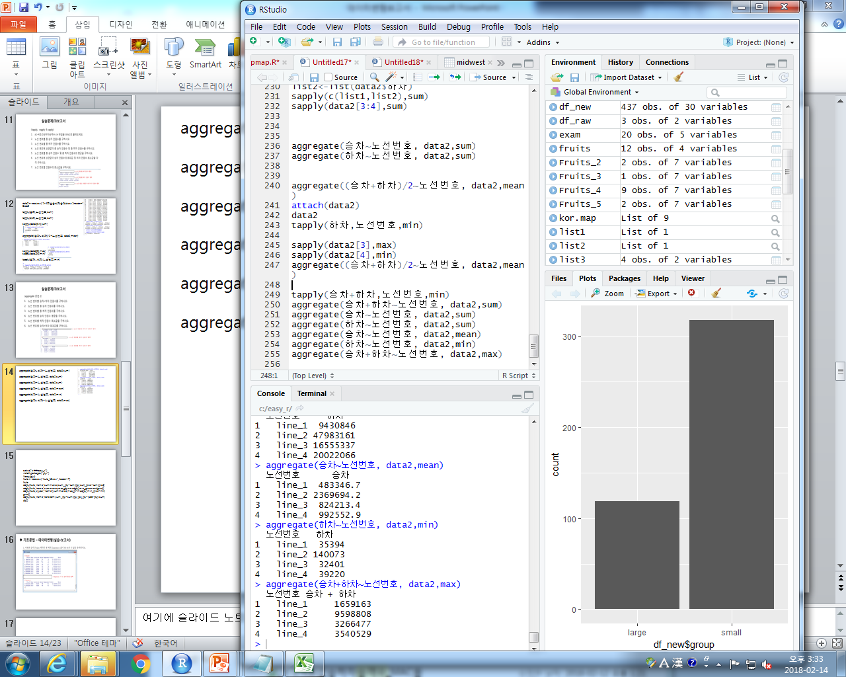
aggregate(승차+하차~노선번호, data2,sum)
aggregate(승차~노선번호, data2,sum)
aggregate(하차~노선번호, data2,sum)
aggregate(승차~노선번호, data2,mean)
aggregate(하차~노선번호, data2,min)
aggregate(승차+하차~노선번호, data2,max)

Slide 15
setwd("c:\\easy_r")
install.packages("plyr")
library(plyr)
fruits<-read.csv("fruits_10.csv",header=T)
fruits
ddply(fruits,'name',summarise,sum_qty=sum(qty),sum_price=sum(price))
ddply(fruits,'name',summarise,max_qty=max(qty),min_price=min(price))
ddply(fruits,c('year','name'),summarise,max_qt=max(qty),min_price=min(price))
ddply(fruits,'name',transform,sum_qty=sum(qty),pct_qty=(100*qty)/sum(qty))

Slide 16
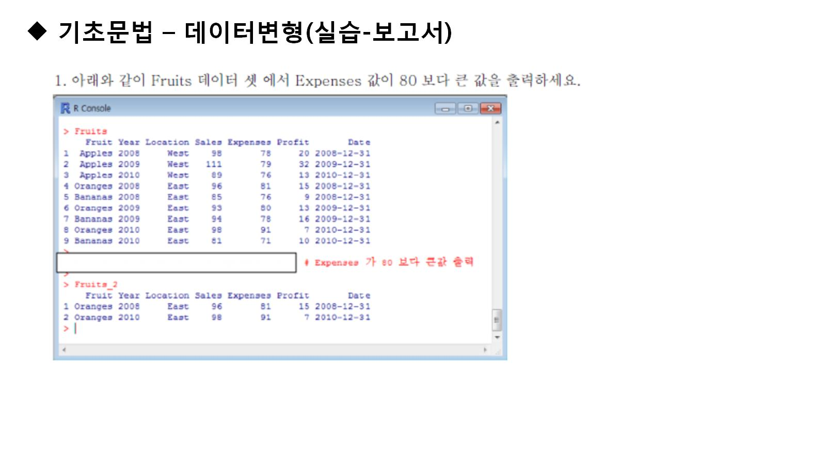

Slide 17
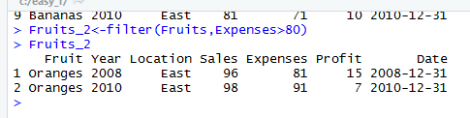
install.packages("googleVis")
attach(Fruits)
Fruits
Fruits_2<-filter(Fruits,Expenses>80)
Fruits_2

Slide 18
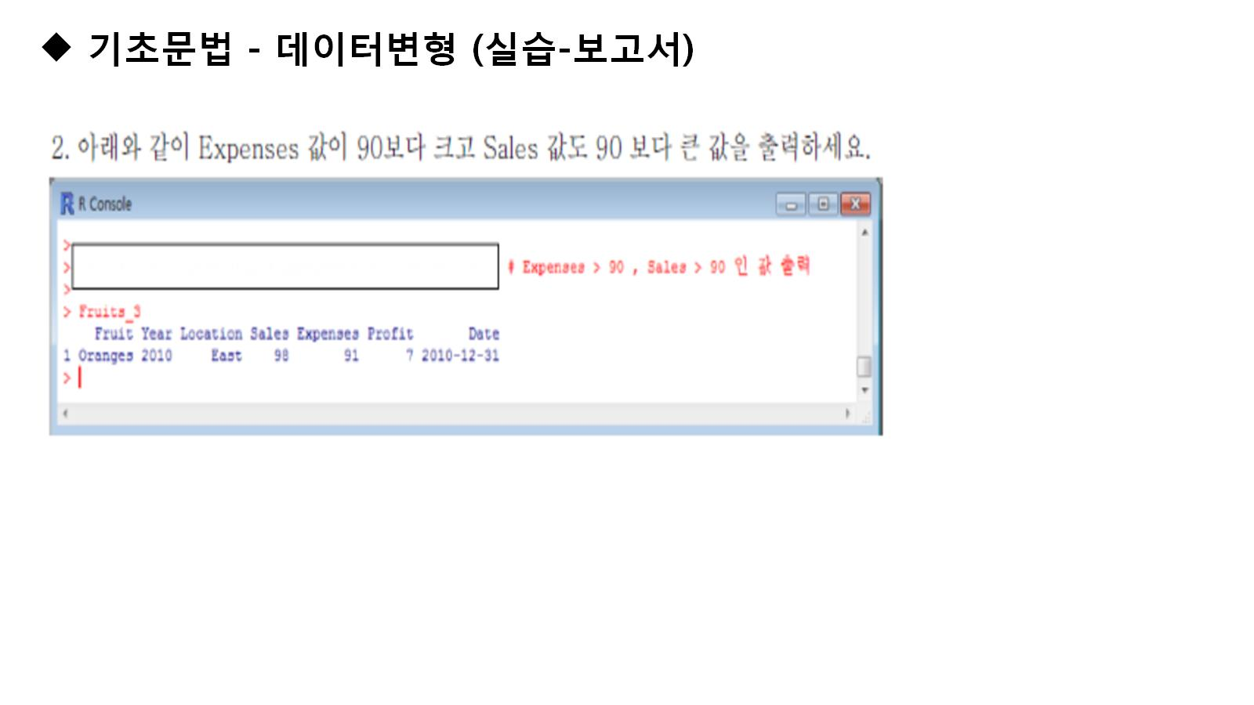
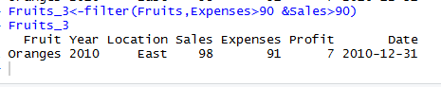
Fruits_3<-filter(Fruits,Expenses>90 &Sales>90)
Fruits_3

Slide 19
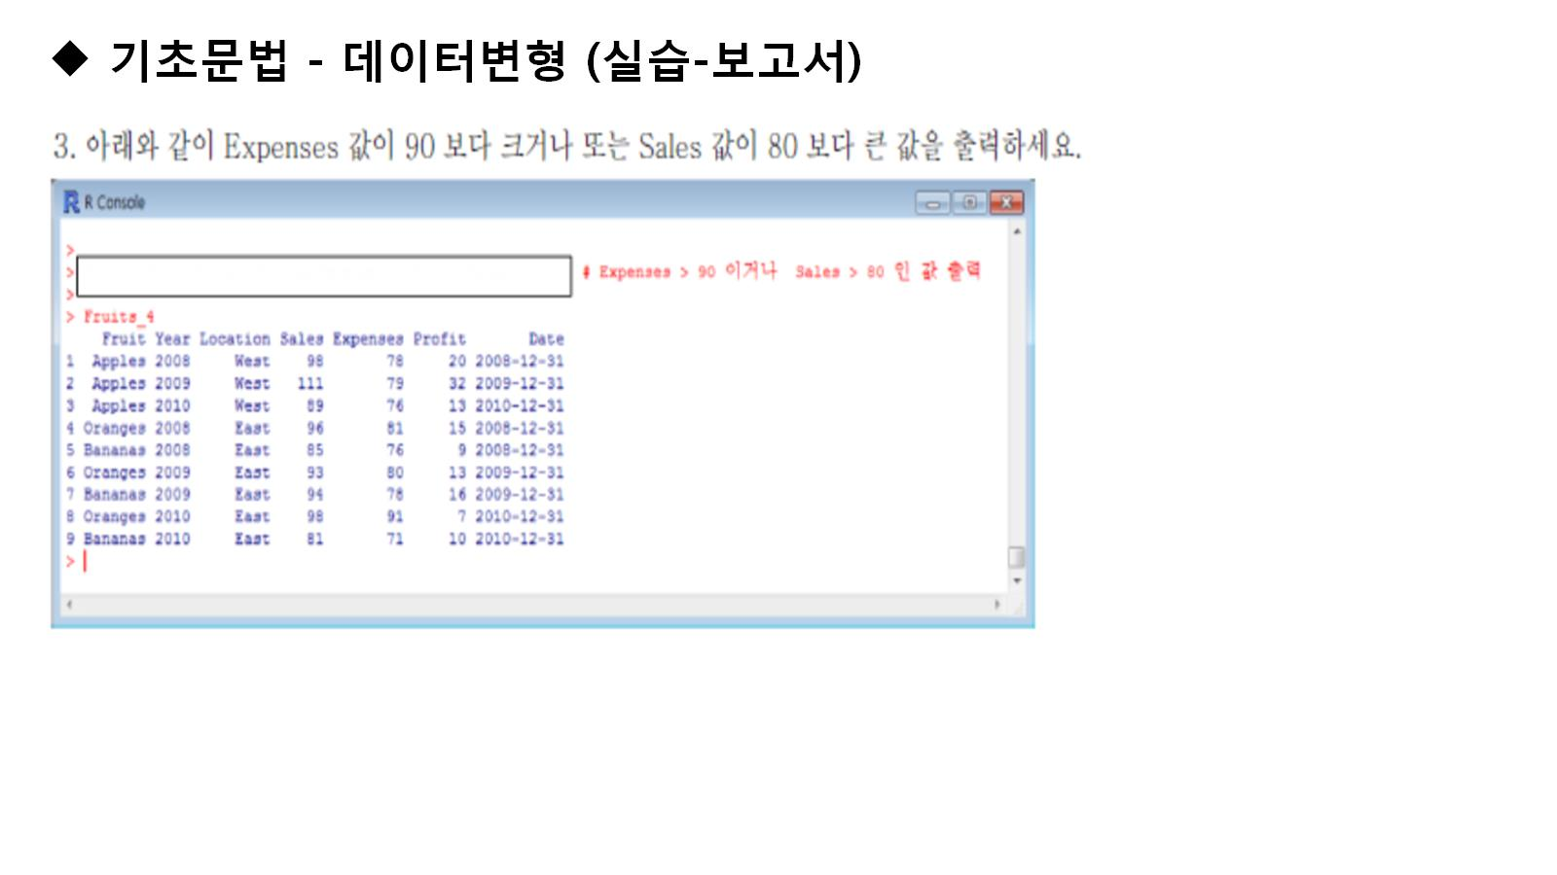
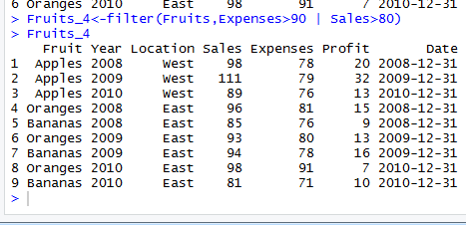
Fruits_4<-filter(Fruits,Expenses>90 | Sales>80)
Fruits_4

Slide 20
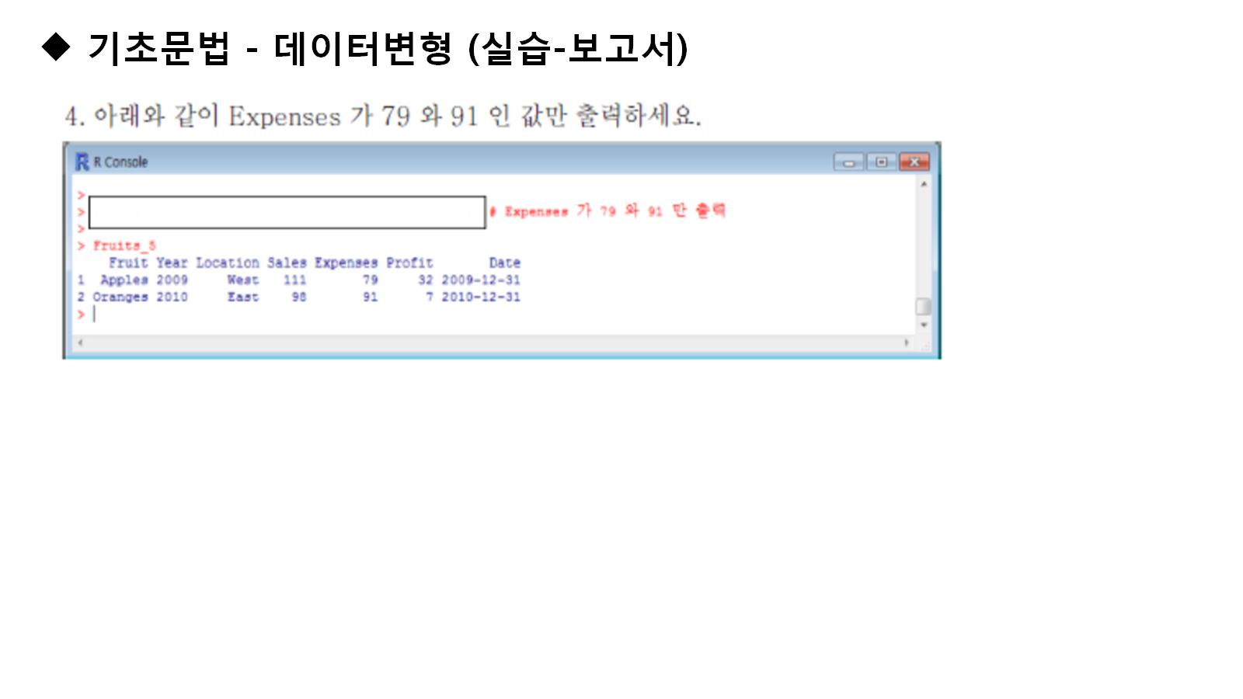
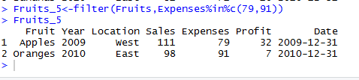
Fruits_5<-filter(Fruits,Expenses%in%c(79,91))
Fruits_5

Slide 21
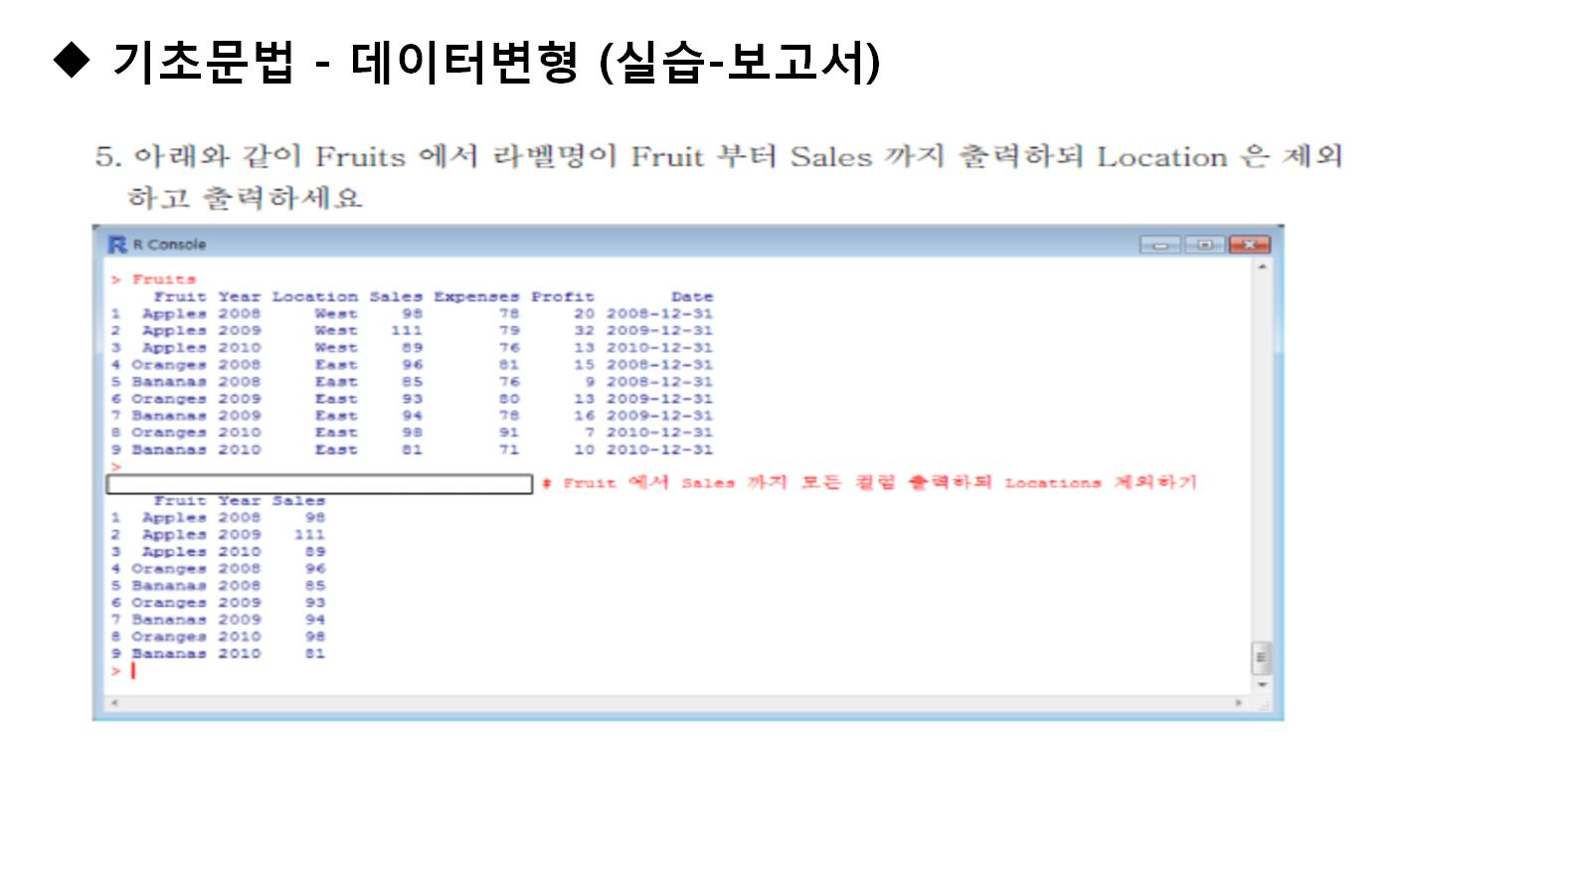
select(Fruits,Fruit,Year,Sales)

Slide 22
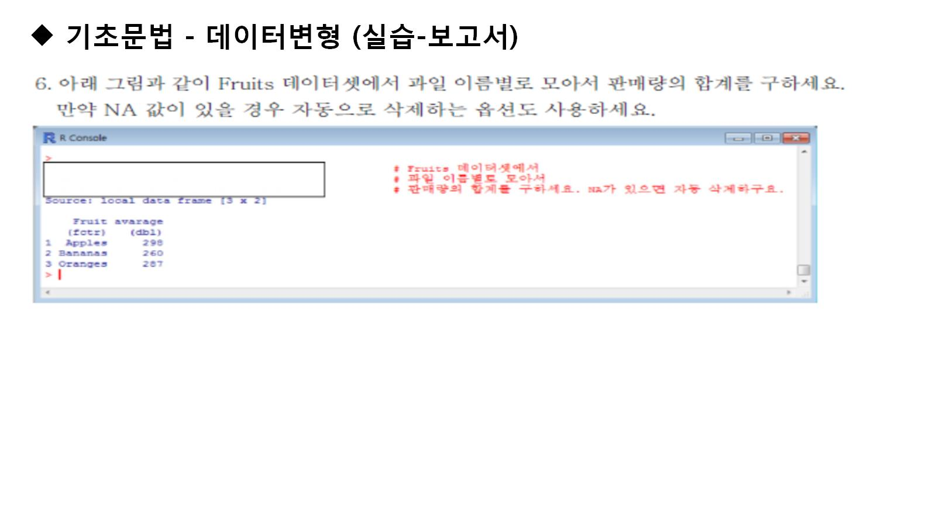
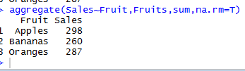
install.packages("googleVis")
attach(Fruits)
Fruits
aggregate(Sales~Fruit,Fruits,sum,na.rm=T)

Slide 23
